Slide 1
TOUR AND TRAVEL BUDDY
TEAM NAME:- EXPLORER
SUBMITTED TO :
Ms. Rachana Yadav
Assistant professor (SOET)
SUBMITTED BY :
Ritika Kaushal (backend Developer)
Anjali Bothra (java Developer)
Yashi Audichya (Designing)

Slide 2
CONTENT
S NO. | TITLE
1 | Introduction
2 | Problem Statement
3 | Techniques Used
4 | Diagrams
5 | Modules
6 | Sample Screenshots
7 | Future Scope
8 | References

Slide 3
Introduction
The Travel Buddy is a Java-based project designed to streamline and automate various aspects of travel planning and management. By leveraging advanced technology and user-friendly interfaces, the Travel Buddy aims to enhance efficiency, convenience, and cost-effectiveness for both travelers and travel administrators.
Moreover, the Travel Buddy simplifies the process of itinerary management by providing intuitive tools for booking flights, hotels, rental cars, and other travel services.
At its core, Travel Buddy is more than just a booking platform; it’s a personalized travel solution tailored to meet your every need. Whether you’re a solo adventurer craving new experiences or a group of friends seeking the next unforgettable journey, Travel Buddy has something for everyone.
Overall, the Travel Management System offers a comprehensive solution for managing all aspects of corporate or personal travel.

Slide 4
Problem Statement
The purpose of website is established fact that Internet users are increasing today. Today One of the main purposes of the website is to facilitate the offline customer online because customers cannot spend their precious time in markets trying to find out the best deal.
Our priority will be our customers and their travel requirements.
There will be many users visiting the portal and hence we require a strong and reliable frontend which can withhold the users on our site.
We will be putting an effort to provide the right choice to the people when they plan a holiday and beware them from the false advertising.

Slide 5
Techniques Used
1. User Interface Design using Java Swing and AWT:
Java Swing and AWT are used to create a graphical user interface (GUI) with various components such as buttons, text fields, labels, and tables.
Swing's rich set of components and AWT's lightweight components are utilized to design an intuitive and responsive UI.
2. Database Connectivity with SQL:
SQL (Structured Query Language) is employed for database management.
JDBC (Java Database Connectivity) API is utilized to establish a connection between the Java application and the SQL database..
3. Security Measures:
Password encryption: User passwords are encrypted before storing them in the database to ensure data security.
Role-based access control: Different user roles (e.g., admin, regular user) are implemented to control access to various functionalities and data within the system.
4. Error Handling and Validation:
Input validation: The system performs validation checks on user inputs to prevent incorrect or malicious data
Error handling: Proper error handling mechanisms are implemented to gracefully handle exceptions.

Slide 6
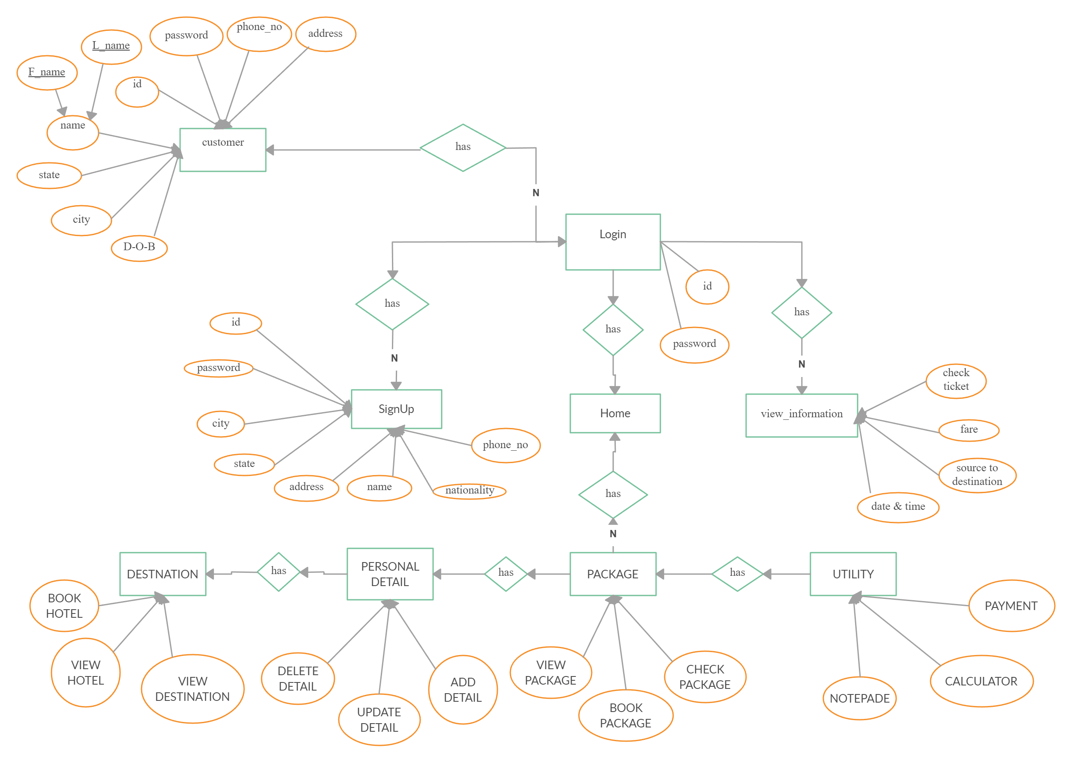
ER DIGRAM

Slide 7
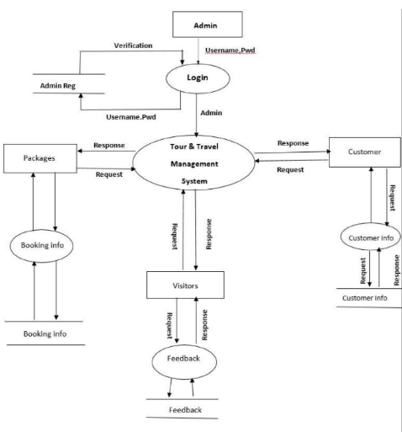
Data flow diagram DFD For Admin:-

Slide 8
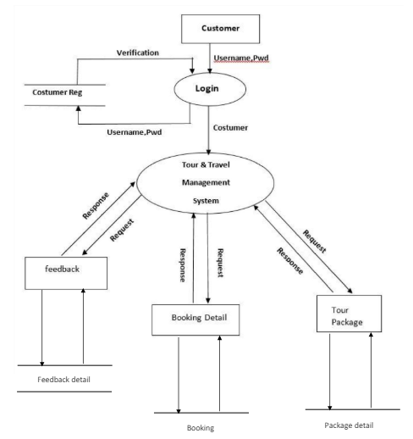
Data flow diagram DFD For User:-

Slide 9
Modules of project
CUSTOMER :-
1. REGISTRATION
2. VIEW PACKAGES
3. BOOKING
4. DESTINATION
5. GIVE E-PAYMENT
6. BOOKING CANCELLATION
7. GIVE FEEDBACK
ADMIN :-
1. REGISTRATION (LOGIN)
2. MANAGING USER
3. MANAGE TOUR PACKAGES
4. MANAGE TICKET BOOKING
5. MANAGE E-PAYMENT
6. VIEW CANCELLATION
7. VIEW FEEDBACK

Slide 10
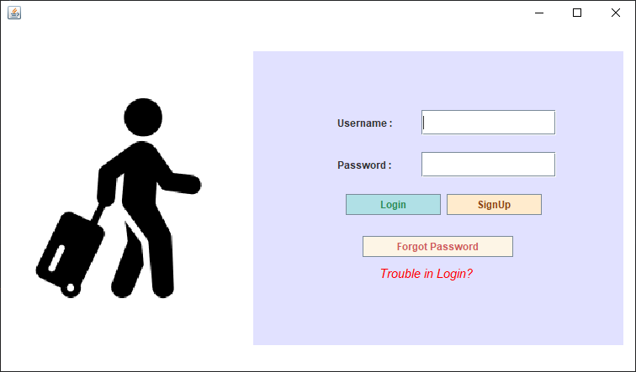
PROJECT SCREENSHOTS
LOGIN PAGE :-
DESCRIPTION:-Login page of tour and travel management system

Slide 11
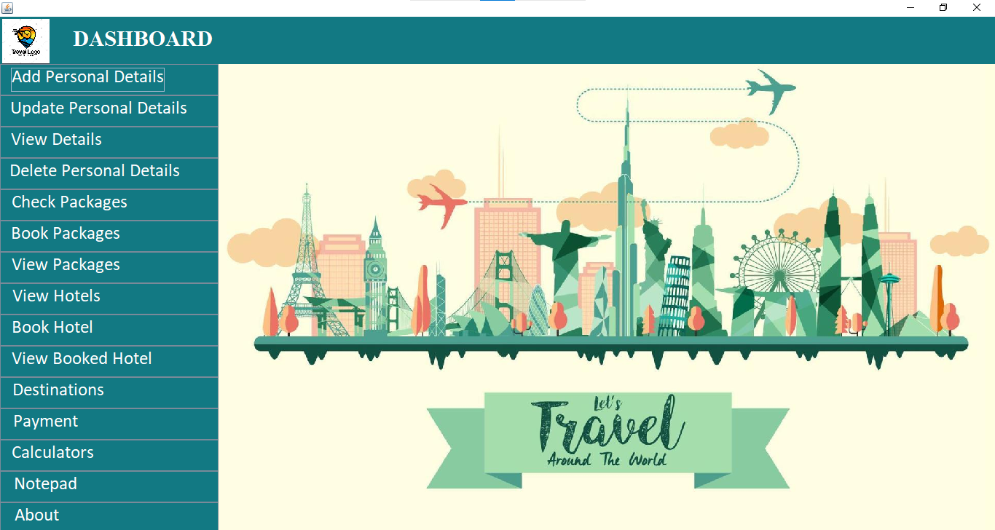
HOME PAGE :-
DESCRIPTION:- HOME PAGE OF TOUR AND TRAVEL MANAGEMENT SYSTEM

Slide 12
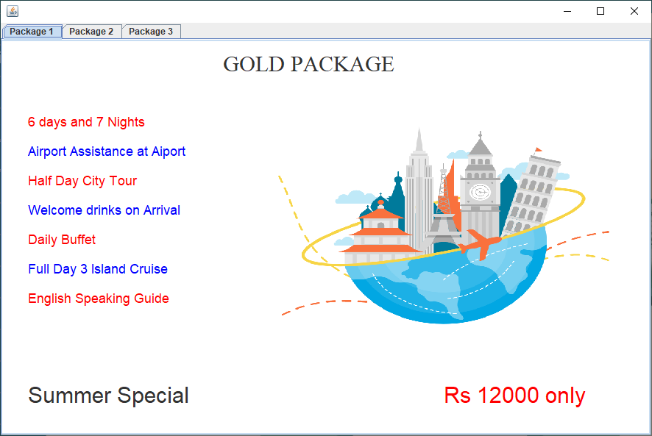
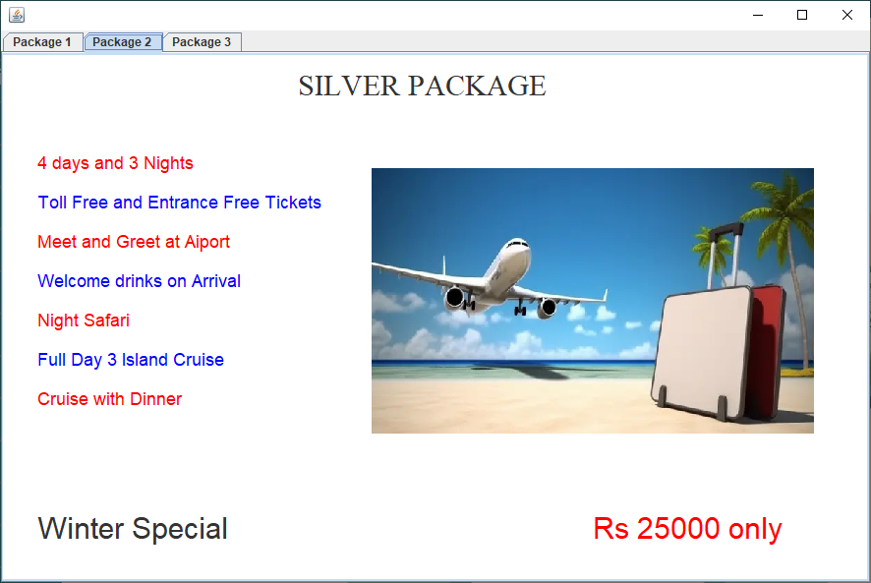
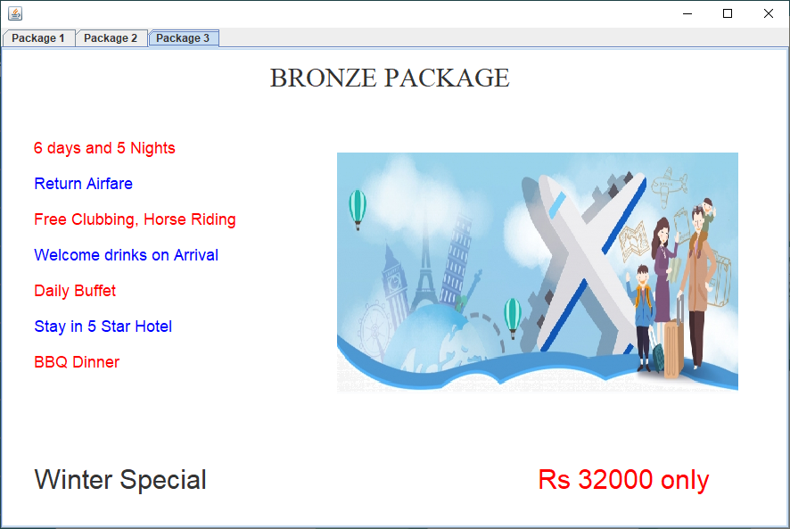
TOUR PACKAGES:-
DESCRIPTION:- DETAILS OF AVAILABLE TOUR PACKAGES

Slide 13
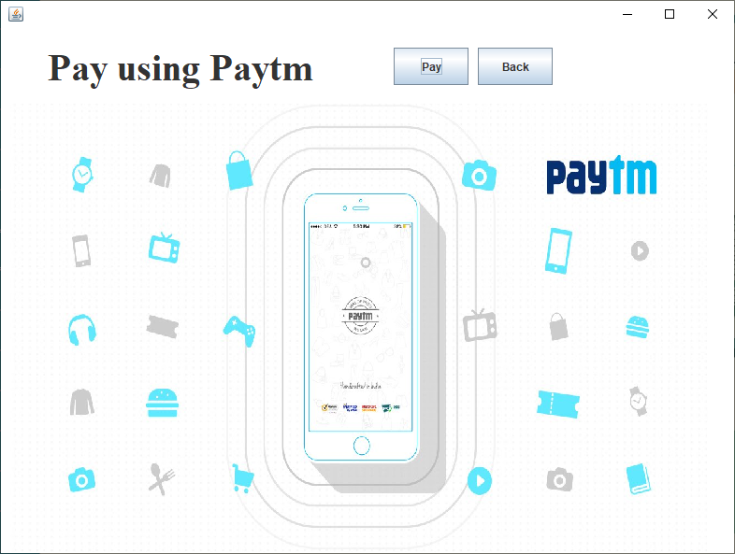
Payment:-

Slide 14
FUTURE SCOPE
We will include more functionality as per the user requirements.
We want to improved our home page, as it is the main thing which attracts all user.
Not a single website is ever consider as complete forever firstly because there is always something new requirement also are growing day by day.
Adding a chat option to interact with other travelers and admin

Slide 15
REFERENCES
https://www.wikipedia.com
https://www.indiaToursOnline.com
https://www.realitytoursandtravel.com
https://www.expedia.com
https://www.booking.com
https://www.airbnb.com
https://www.travelocity.com
https://www.orbitz.com

Slide 16
THANK YOU

